Slide 1
Bank Marketing Campaign Modeling
Yan Xu
Feb 9, 2021

Slide 2
Agenda
Problem Statement and Objectives
Data Overview and Data Cleaning
Exploratory Data Analysis
Current Model Performance
Modeling
Conclusions
Q & A

Slide 3
Problem Statement and Objectives
Problem Statement – To help banking institution determine, in advance, clients who will be receptive to a marketing campaign
Objectives: Finding Data Patterns, Cleaning Data and Evaluate Current Model Performance, and/or Build New Model

Slide 4
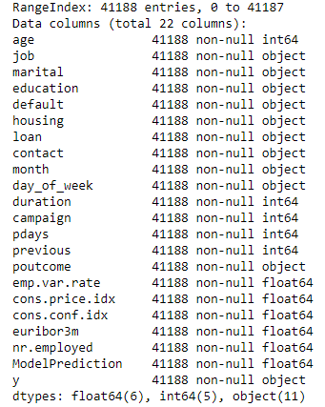
Data Overview and Data Cleaning
Data Structure Overview
Shape of Dataframe: 41188 rows X 22 columns
11 numerical features, 11 categorical features
ModelPrediction(numerical) will only used to evaluate current model performance
Data Cleaning
No Missing Values in all columns of the dataset
There are 12 duplicated rows were removed. The remaining 41176 rows will be used for data analysis

Slide 5
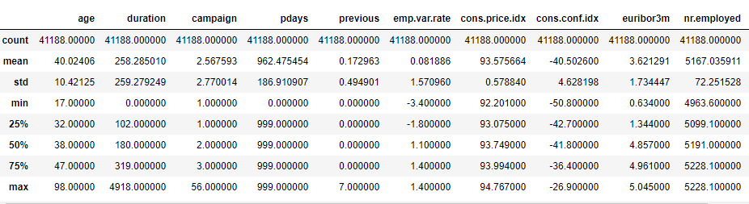
Data Overview and Data Cleaning-Cond
Age: no obvious outliers, mean=40, median=38. Median<mean, the distribution will be slightly right-skewed
Duration: 4918 may be an outlier, mean = 258, median=180. Median << mean, the distribution will be right-skewed
Campaign: 56 may be an outlier, 75% of the clients were contacted 3 times or less
Pdays: majority of values are 999 which means most clients were not previously contacted
Previous: majority of the values are 0 which means most clients were not contacted before the campaign
Emp.var.rate, euribor3m, nr.employed: all employment related measurement, no obvious outliers
cons.price.idx, cons.conf.idx: consumer related measurement, no obvious outliers

Slide 6
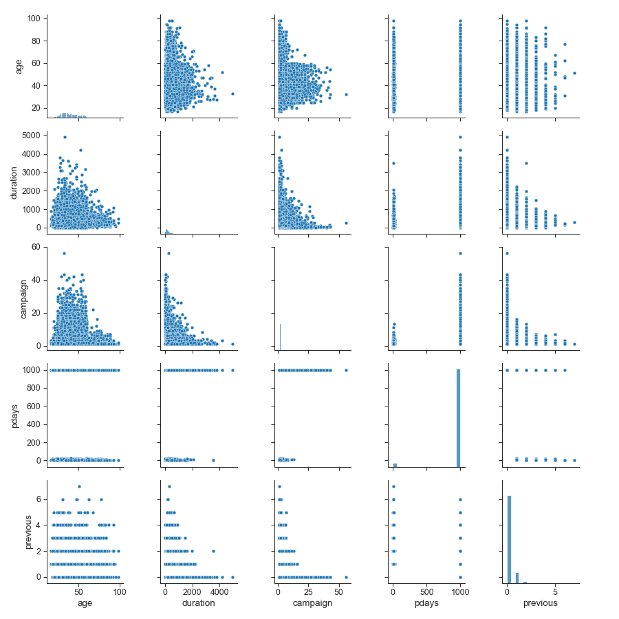
Exploratory Data Analysis-Numerical
First Five Numerical Features: age, duration, campaign, pdays, previous
Negative slope diagonal line are the distribution plots of each feature
Pdays has value either around 1000 or around 0
Previous has values only for certain number, 0 is the most popular one
Age and Duration had right-skewed distribution, median is less than mean

Slide 7
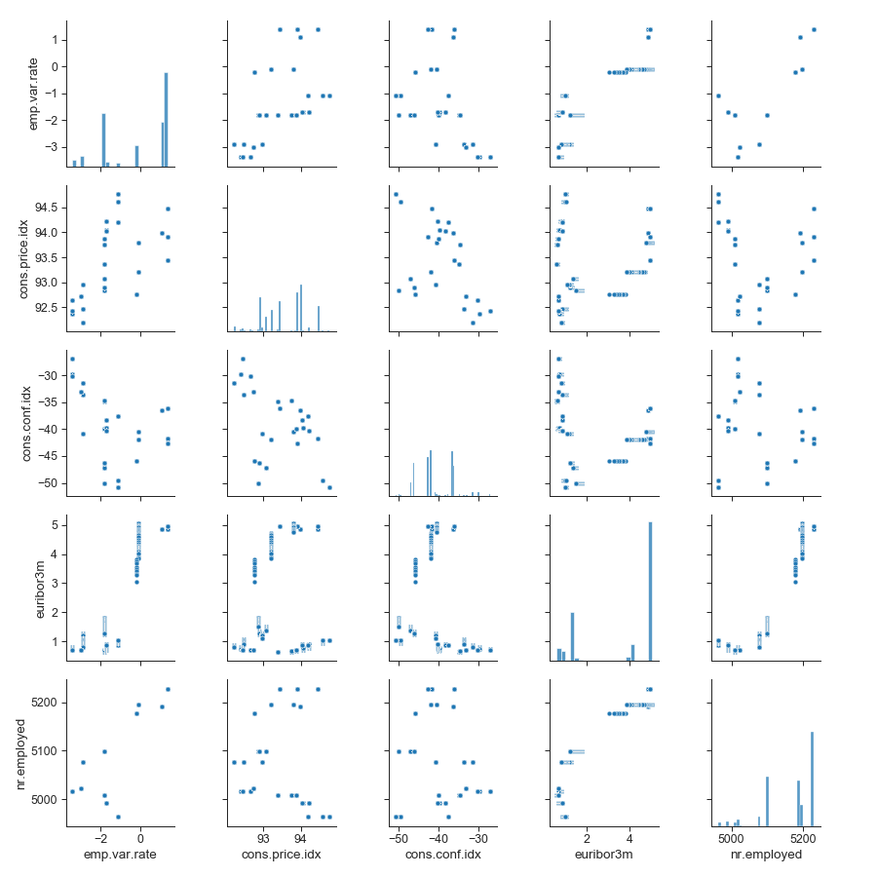
Exploratory Data Analysis-Numerical-Cond
Next Five Numerical Features: emp.var.rate, cons.price.idx, cons.conf.idx, euribor3m, nr.employed
Negative slope diagonal line are the distribution plots of each feature
Three of them look like bimodal
Potential Linear correlation features: emp.var.rate & nr.employed, euribor3m & nr.employed
Most of them looks like randomly scattered

Slide 8
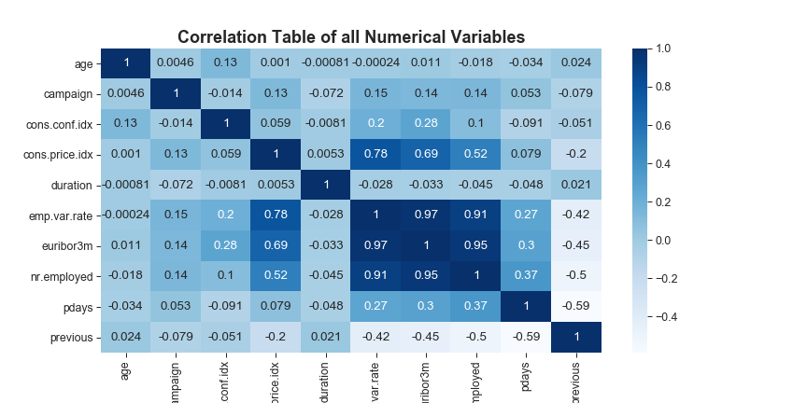
Exploratory Data Analysis-Numerical-Cond
High correlation features: emp.var.rate, euribor3m, nr.employed
Median correlation features: cons.price.idx with three employment status measurements, pdays and previous
Multicollinearity issue: increase variance of our model coefficient, make it sensitive to minor changes in the model
Two ways to mitigate: 1. remove highly correlated features. 2. Principal Component Analysis

Slide 9
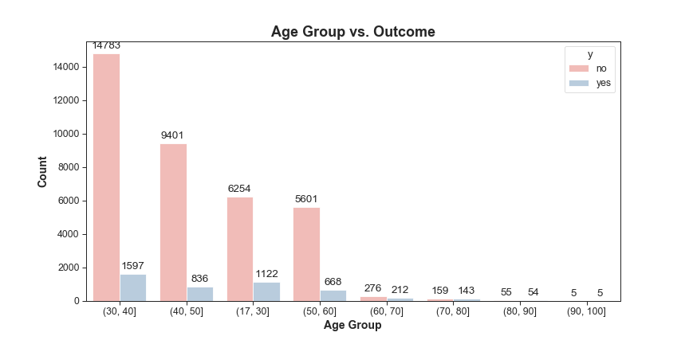
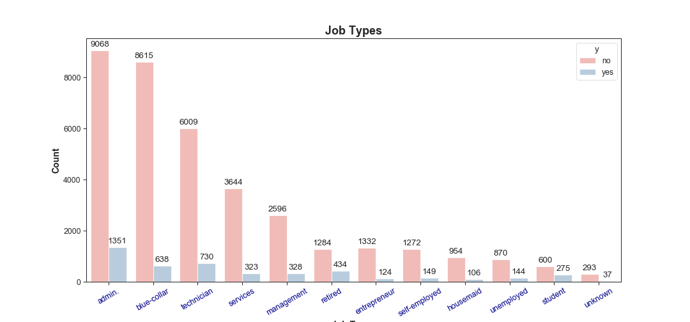
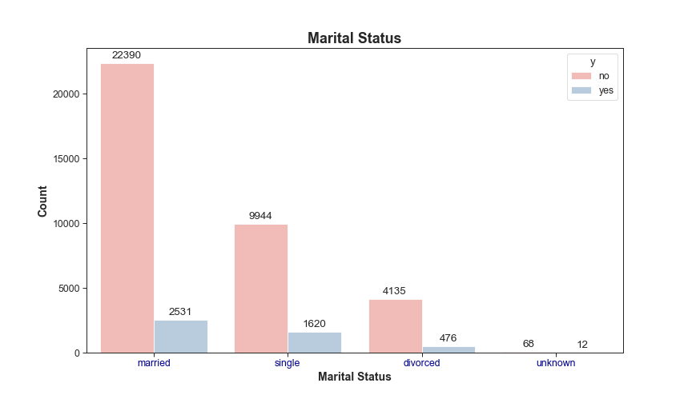
Exploratory Data Analysis-Categorical
Age Group: 30-40 and 17-30 are the two age groups that had the most positive feedbacks on the campaign
Job Types: admin and technician are the top 2 job types that had the most positive feedbacks
Marital Status: both married and single persons respond to campaign positively

Slide 10
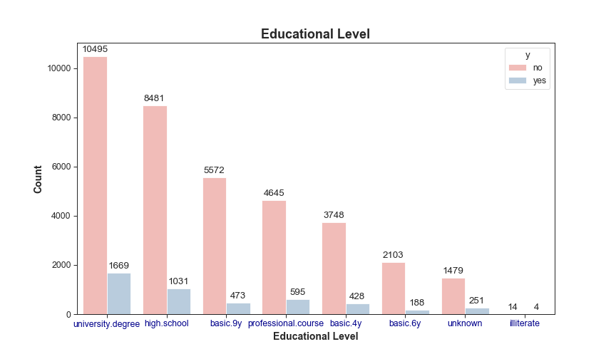
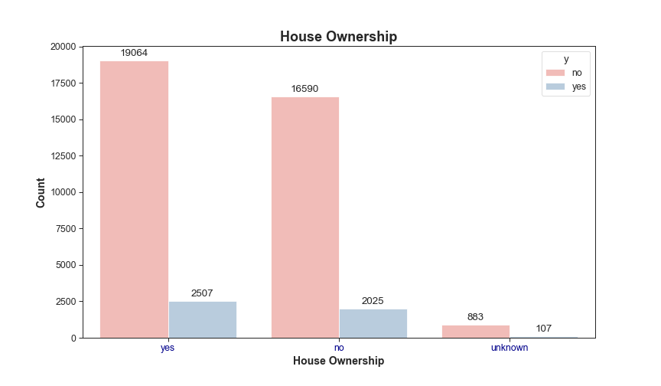
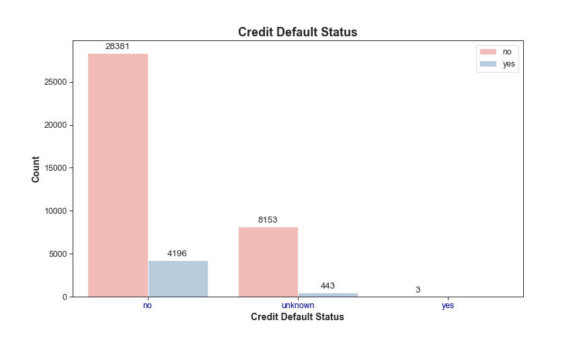
Exploratory Data Analysis-Categorical Con’d
Educational Level: people with an university degree or high school graduate are the top 2 group of people with most positive feedback
House Ownership: people who own a house respond slightly more positive than who does not own
Credit Default Status: people who has no credit in default are more likely to say yes

Slide 11
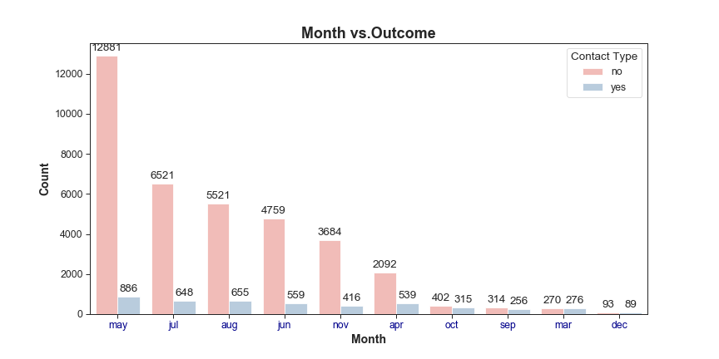
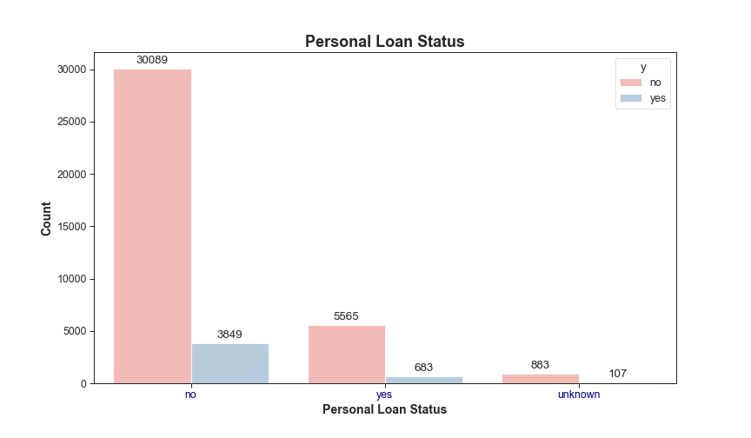
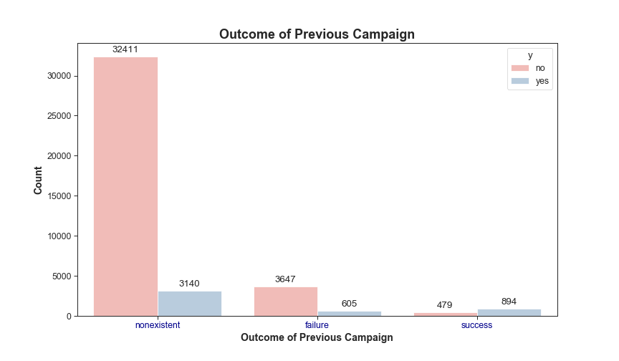
Exploratory Data Analysis-Categorical Con’d
Month: May, July and August are the three months that receives most positive feedback
Personal Loan Status: people who has no personal loan is more likely to say yes
Outcome of Previous Campaign: people who was not in previous marketing campaign is more likely to say yes

Slide 12
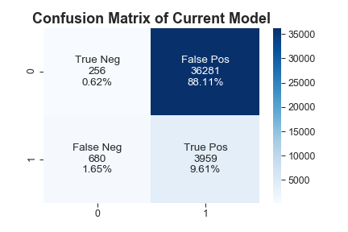
Current Model Performance
The actual result of current campaign: yes: 4,639(11%), no: 36,537(89%)
The accuracy score of the current model is: 0.11
Correctly predicted most of the clients who said Yes (3,959 out of 4,639 or 85%)
88% of the model predicted results are False Positive. Those are the clients should have not been contacted, but the model suggested to do so
1.65% of the model predicted results are False Negative. Those are the clients should have contacted
From the accuracy score, the bank should replace current model with a new model.

Slide 13
Modeling-Data Pre-processing
Due to potential multicollinearity issue, features emp.var.rate and euribor3m will be excluded from the model since both of them had the biggest correlation coefficient with other features
Take out unnecessary columns- ModelPrediction(current model results), duration(will have big impact on the modeling results, is not known until the result is known), and agegrp1(created feature)
Convert ‘pdays’ and ‘contact’ into binary (0 or 1)
Separate ‘y’ column from the remaining columns, the remaining columns will be the input features to the model
Perform one-hot encoding on the input features to convert categorical features into numerical

Slide 14
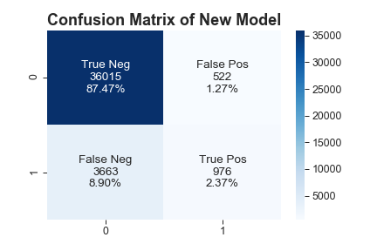
Modeling-Logistic Regression
Split both input and ‘y’ into training and testing dataset with a 30% Test and 70% Train split ratio
The accuracy score of the Logistic Regression model is: 0.89
Correctly predicted most of the clients who said No(36,015 out of 36,537 or 99%)
87% of the model predicted results are True Negative. That helped bank to save time and labor to contact people should not be contacted
But there are a 8.9% False Negative, those are the clients bank should have contacted, but the model predict to not contact. This will be the lost revenue opportunities.

Slide 15
Conclusions
Ideal clients persona
Age between 17-40
Professionally work either as an admin or technician
Could be married or single
Have a university degree or high school diploma
Own a house, is not in credit default and do not have personal loan
Summer time(May, July, August) are the best time to contact clients
Current Model Performance
Overall accuracy is low ~ 11%
But correctly predicted most of the clients who said Yes (3,959 out of 4,639 or 85%)
Potential extra cost of contacting large amount of False Positive clients
New Model Performance
Overall accuracy is high~89%
Correctly predicted most of the clients who said No(36,015 out of 36,537 or 99%)
Potential lost of revenue for not contacting False Negative clients

Slide 16
Q & A

Slide 17
Thank You

Slide 18
Backup 1. Monetize the Confusion Matrix
Assume the cost of contacting each potential client is $20, the revenue can be generated from each client that has been successfully subscribed is $100 per client
Current Model: Cost = (36,281+3,959) x $20 = $ 804,800, Revenue= 3959 x $100= $395,900. Potential client’s revenue ( a cost to bank)=680x$100 = $68,000. Overall, $395,900 – $804,800 - $68,000=$ -476,900
New Model: Cost = (976+522) x $20 = $29,960, Revenue=976x$100= $97,600, Potential Client’s revenue( a cost to bank) = 3,663 x $100 = $366,300. Overall, $97,600 - $29,960 - $366,300 = $-298,660

Slide 19
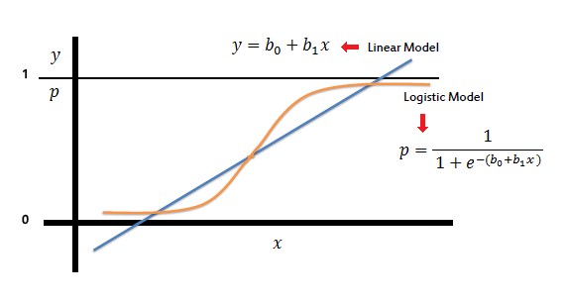
Backup 2. Logistic Regression
A go-to method for binary classification problems
Logistic Regression is a linear method
The output is a probability (of success or failure) that depends on continuous inputs

Slide 20
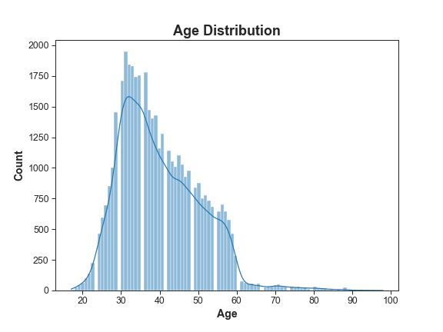
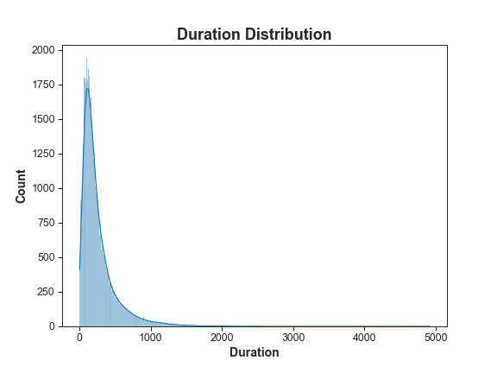
Backup 3. Age and Duration Distribution
Age Distribution: slightly right-skewed
Duration Distribution: right-skewed

